Slide 1
HOSPITAL RE-ADMISSIONS ANALYSIS
Exploration of insights of a data containing hospital re-admission details and communicating through visualizations.

Slide 2
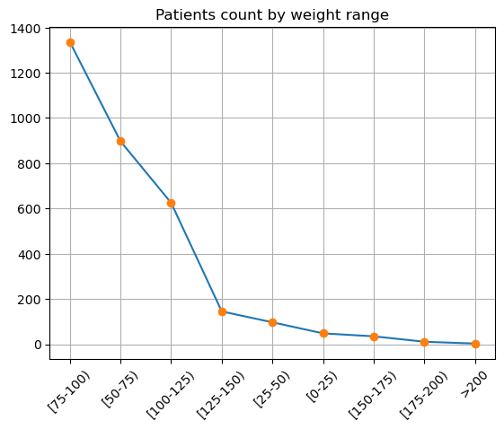
The above graph shows that most patients have weight range between 75-100 pounds and patients with weight more than 200 pounds are the least.

Slide 3
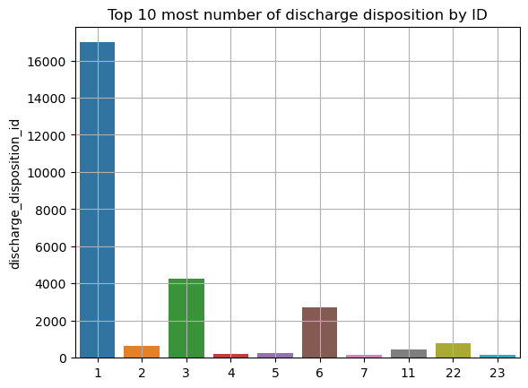
The graph shows that most number of patients dispositioned were of discharge disposition ID 1.

Slide 4
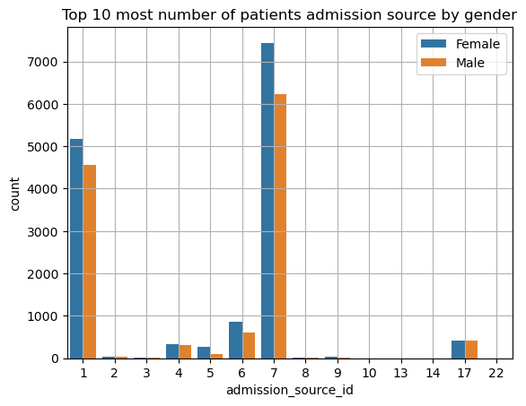
Most patients admitted to hospital were having admission source ID 7.

Slide 5
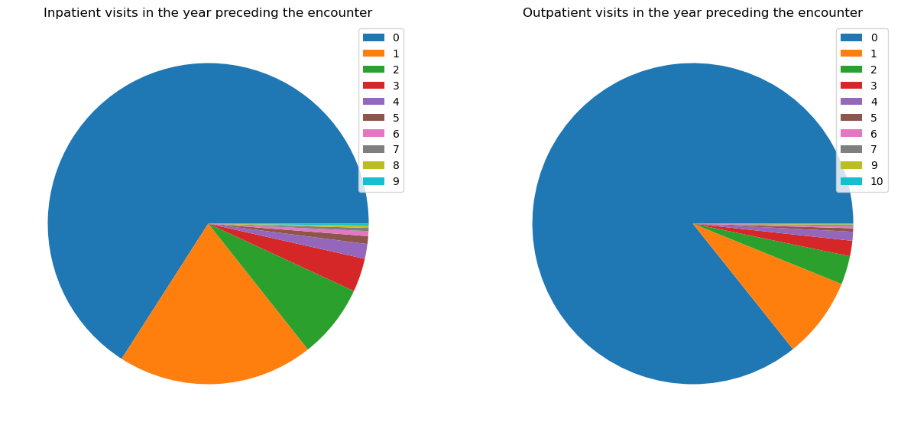
INPATIENT VISITS VS. OUTPATIENT VISITS
Inpatient Visits:
Majority of the patients had no inpatient visits in the year preceding the encounter.
Outpatient Visits:
Majority of the patients had no outpatient visits in the year preceding the encounter.

Slide 6
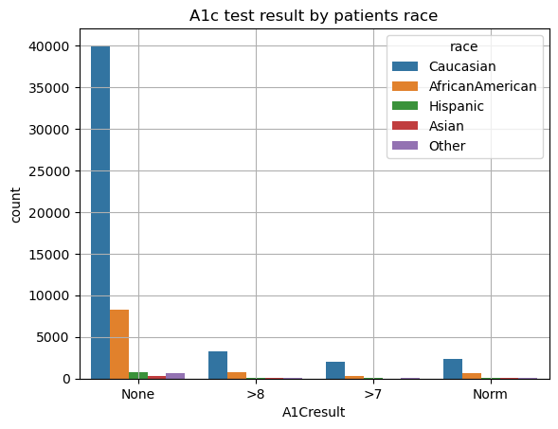
The graph indicates that most Caucasian patients have not given their A1c tests which are followed by African-American patients.

Slide 7
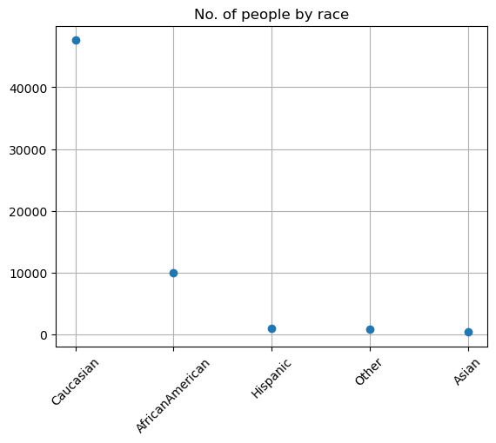
Most diabetic patients admitted in the hospital are Caucasian.

Slide 8
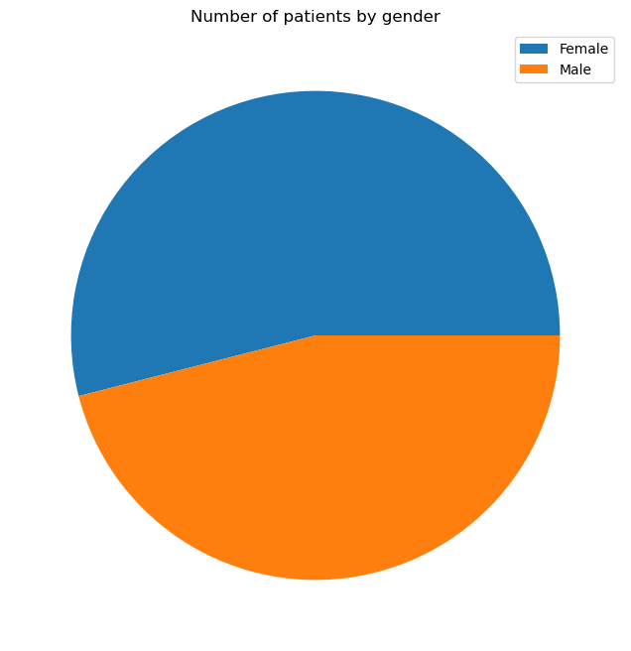
The graph shows that more than half of the total patients' population are females.

Slide 9
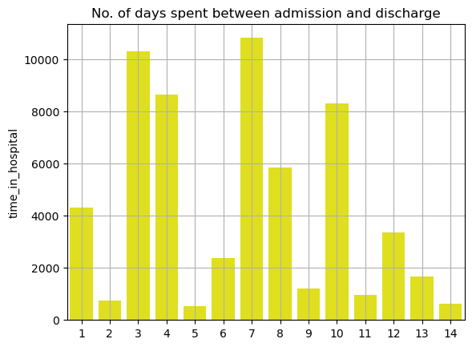
We observe that most patients are discharged in 7 days from admission.

Slide 10
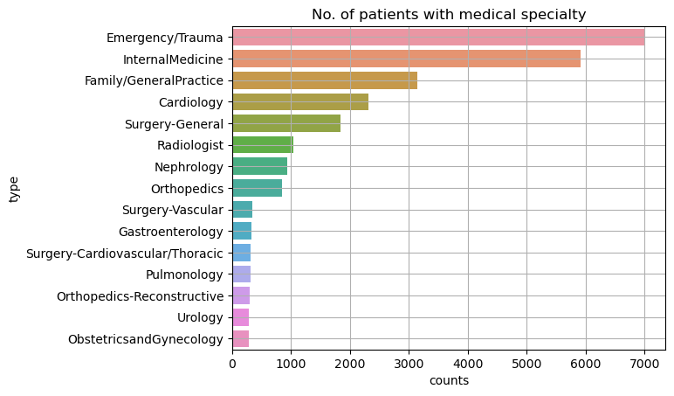
Majority of the patients were admitted due to emergency/trauma medical reasons.

Slide 11
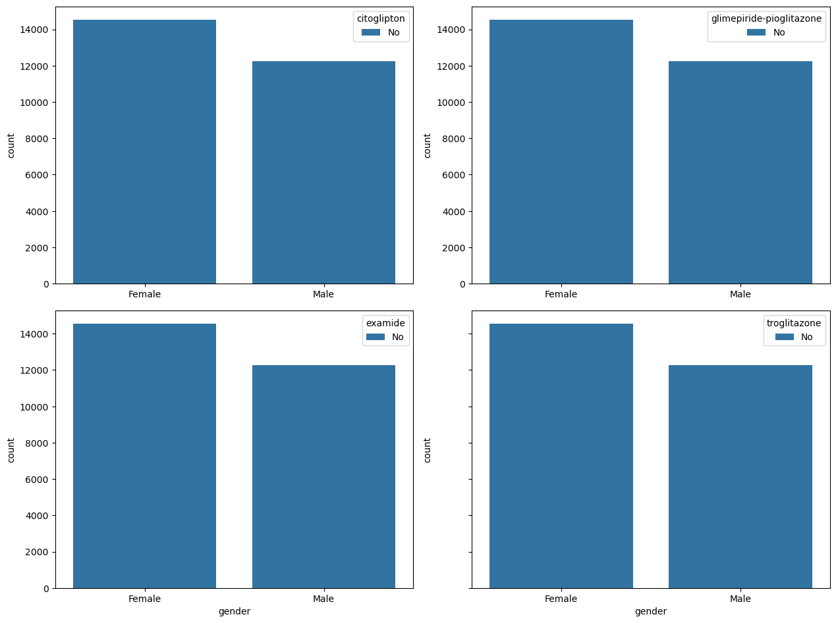
Patients in regards with gender having no medicine levels
The subplots convey that most female patients showed no signs of any medicine levels.

Slide 12
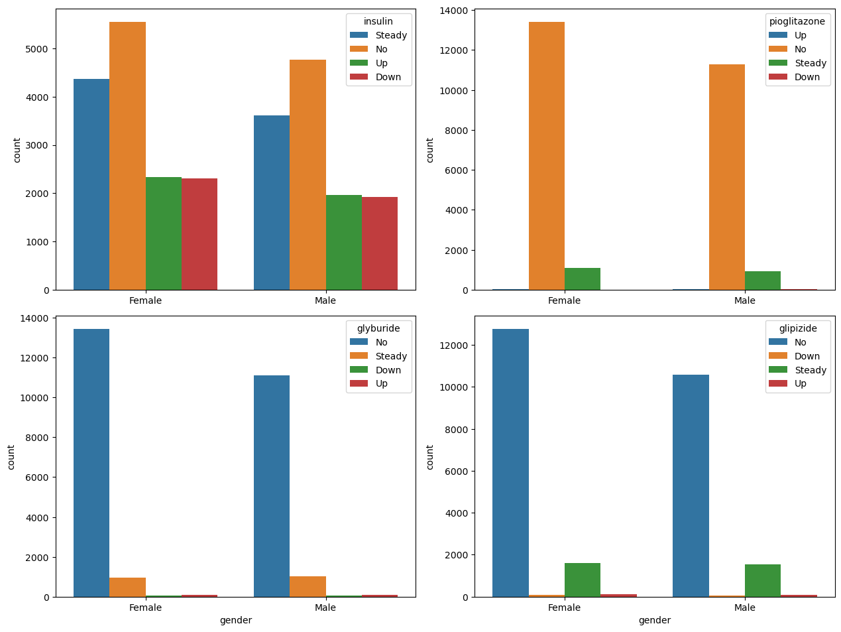
Patients in regards with gender having medicinal levels
The plots show that most female patients showed no signs of any medicine levels.

Slide 13
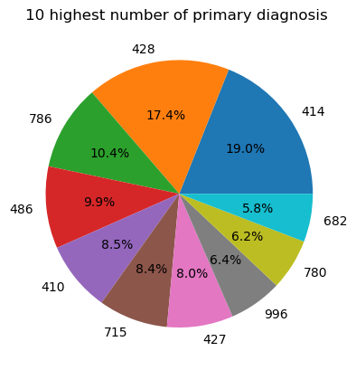
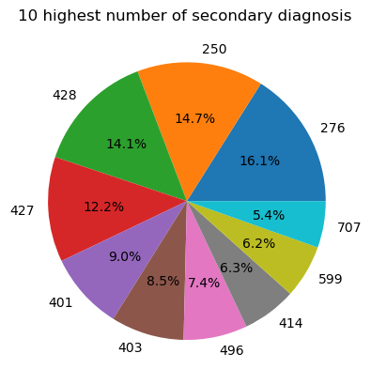
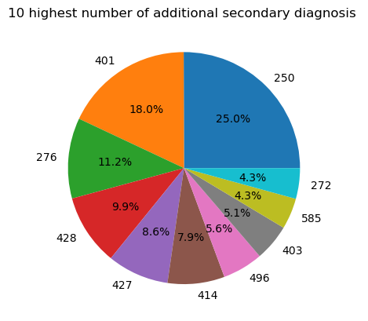
The part of the patients with primary diagnosis (coded as first three digits of ICD9) are 414 and 428 are nearly equal with code 428 holding slightly higher number of share.
The part of the patients with secondary diagnosis (coded as first three digits of ICD9) are 250 and 428 are nearly equal with code 250 holding slightly higher number of share.
The most part of the total patients with additional secondary diagnosis (coded as first three digits of ICD9) is with code 250.

Slide 14
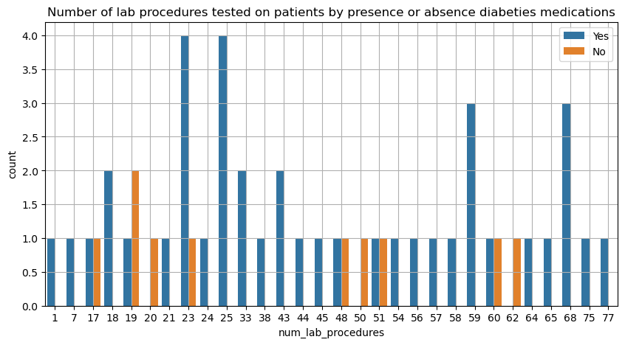
The graph shows that highest number of patients in the presence of the diabetic medication were testing for about 23 to 25 lab procedures whereas highest number of patients with no diabetic medications were tested for 19 lab procedures.

Slide 15
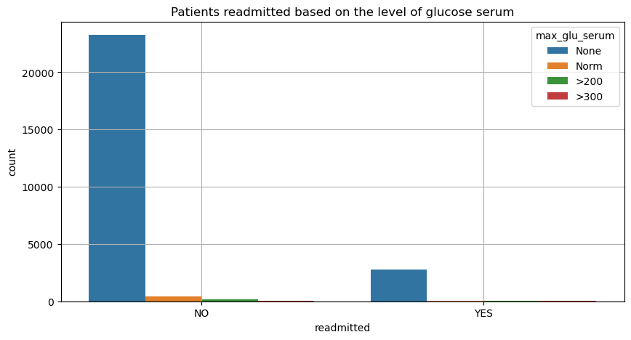
The graph shows clear observation that majority of patients readmitted had no glucose serum test with majority of them not readmitted.

Slide 16
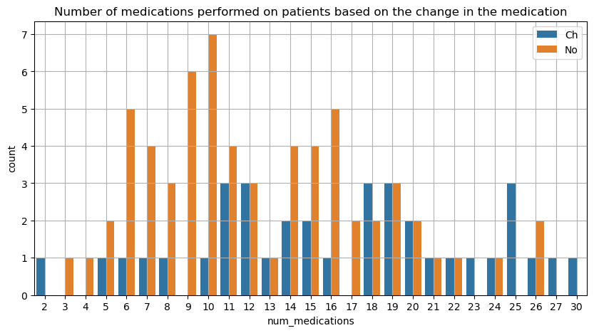
The graph shows that highest number of patients with change in their medications had 16 medications whereas patients with no change had highest number with around 12 to 13 medications.

Slide 17
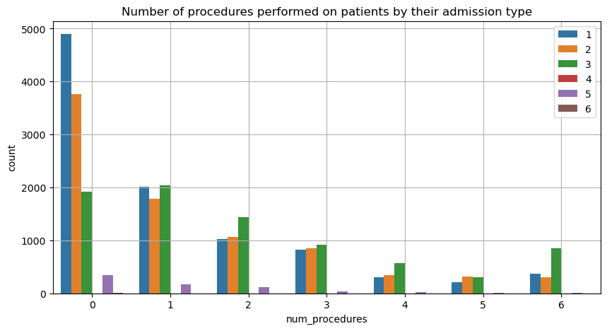
The patients with admission ID 1 had no procedures performed on them which was the highest number on an individual level.

